Slide 1

Capstone 2 Smart Job Search Agent: Extracting Skills & Opportunities
Tania Tasmin
DataTalent - Cohort 18
Oct 28, 2025

Slide 2
Project Overview
Automates extraction of job information from Canadian job sites
Extracted data : Job Title, Employer, Location, Work Mode (Onsite/Hybrid), Experience needed, Tools, Technical Skills, and other skills
Match the user’s skills with the job skills

Slide 3
Objective
Make the job search process faster and more efficient
Provide structured, searchable datasets of current job listings
Highlight key skills and tools required in the market
Assess the match between your skills and the required skills using a similarity score

Slide 4
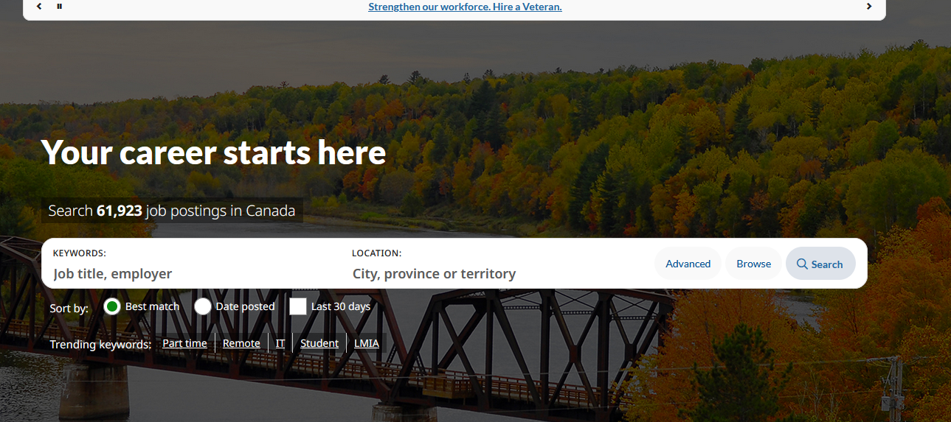
WebSites to Scrape
https://www.jobbank.gc.ca/home

Slide 5
Tools Used
Selenium: Browser automation
XPath: Locating elements on webpage
Gemini 2.5 + Prompt Engineering: Extracting structured information from job descriptions
Numpy and Pandas: Data Cleaning
Sklearn: feature extraction and calculating similarity

Slide 6
Web Scraping
Open target job website using Selenium
Navigate to job listings
Use XPath locators to identify elements
Extract raw text for job tasks/requirements
Use Gemini + prompt engineering to parse and extract technical skills
Depending on the experience and skills required, decide the job level
Store results in structured format (CSV)

Slide 7
Compare Job-seeker’s skill with the job skill
Data Preparation
Create a combined skills column using the tools and technical skills columns of the dataset
Use the combined job skills column from the dataset and the user’s skill list for comparison.
Text Preprocessing
Clean and normalize text (lowercasing, removing punctuation, stopwords, etc.) to ensure consistent representation.

Slide 8
Compare Job-seeker’s skill with the job skill
Vectorization
Convert both job skills and user skills into numerical vectors using TF-IDF or CountVectorizer.
Similarity Computation
Calculate the cosine similarity score between the user’s skill vector and each job’s skill vector to determine the best matches.

Slide 9
Demo

Slide 10
Future Steps
Future Improvements:
Improve the code to extract all jobs
Scraping multiple job sites
Automating daily updates
Adding salary, company, and posting date
Job application Agent

Slide 11
Thank you!

